Slide 1
OscilLometric Blood Pressure
Miodrag Bolic

Slide 2

Blood pressure definitions

Slide 3
Definitions
Auscultatory method is an indirect method to measure arterial blood pressure that relies on the detection of Korotkoff sounds under an occluding cuff.
Electronic sphygmomanometer is an instrument used for the indirect (noninvasive) measurement of arterial blood pressure that automatically determines blood pressure from signals obtained from the cuff and/or a separate transducer.
Oscillometry is an indirect method to measure arterial blood pressure that relies on the measurement of oscillations in an occluding cuff.
Non-invasive blood pressure measurements (NIBP) is normally any cuff-based method for measuring BP
Ambulatory BP monitoring (ABPM) is a noninvasive, fully automated technique in which BP is recorded over an extended period of time, typically 24 hours.
Home blood pressure monitoring (HBPM) that typically involves measurements over a longer periods of time, in stationary position while being awake.

Slide 4
Measuring blood pressure
S. Tavoularis, Measurement in Fluid Mechanics, New York : Cambridge University Press, 2005
One can measure pressure of a fluid inside of a pipe only if a sensor is inserted in it!
Direct measurement of blood pressure is invasive, and, as such, it has a very limited clinical value.
Non-invasive blood pressure measurement is the only application where direct measurement methods from other fields could not be applied for practical and ethical reasons.
BP cannot be measured non-invasively but only estimated from indirect measurements (Korotkov sounds, cuff pressure oscillations, tonometry, etc)
It is the result of internal REGULATION

Slide 5
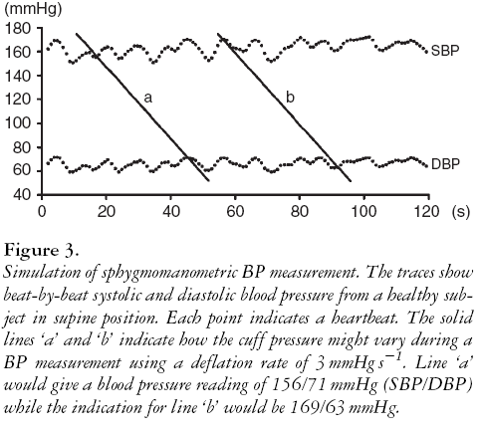
Variability of blood pressure
Up to 20 mmHg
Cardiovascular
Mayer Waves
Respiration
157/71
SBP/DBP
169/63
SBP/DBP

Slide 6
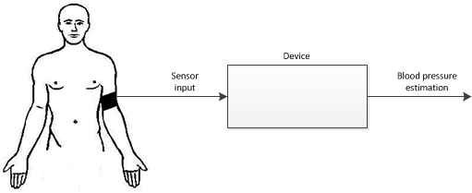
Oscillometric method
A cuff is connected to a subject
A cuff is inflated to a point that the blood does not flow through the artery any more
The pressure is slowly released
As the blood start flowing, the cardiac pulses are superimposed to the cuff pressure
The pressure is measured and oscillometric algorithm is applied to estimate systolic and diastolic pressure

Slide 7
Age & Cuff Deflation Waveform
Pulse waveform at different pressure
Pulse waveforms characteristics change at different pressure points in oscillometric cuff deflation pressure waveform

Slide 8
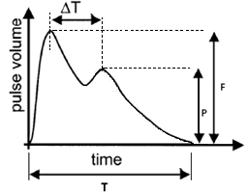
How can we process the pulse
Preprocessing
and
processing
Feature
SYS,
DIA,
MAP
Feature
Time or
Cuff Pressure
Extracting features from a single pulse
Looking at the function: the feature vs. time or vs. pressure
Estimating the values of Systolic and Diastolic from the function.
Notes:
Pulse waveform is a result of complex interaction between the left ventricle and blood circulation system. Pressure signal usually contains more information than is captured BP values and most of this information can be extracted from the pulse morphology,
Pulse represents 1 cycle of arterial blood pressure
Pulse is a graph of pressure over time (figure)
Pulse has first(systolic) peak, and sometime the second peak

Slide 9
How can we process the pulse – Innovation?
Preprocessing
and
processing
Feature
SYS,
DIA,
MAP
Feature
Time or
Cuff Pressure
What features to extract that would lead to determination of SYS, DIA and MAP
that have physiological sense.
that have correlation with age, some conditions,…
Notes:
Pulse waveform is a result of complex interaction between the left ventricle and blood circulation system. Pressure signal usually contains more information than is captured BP values and most of this information can be extracted from the pulse morphology,
Pulse represents 1 cycle of arterial blood pressure
Pulse is a graph of pressure over time (figure)
Pulse has first(systolic) peak, and sometime the second peak

Slide 10
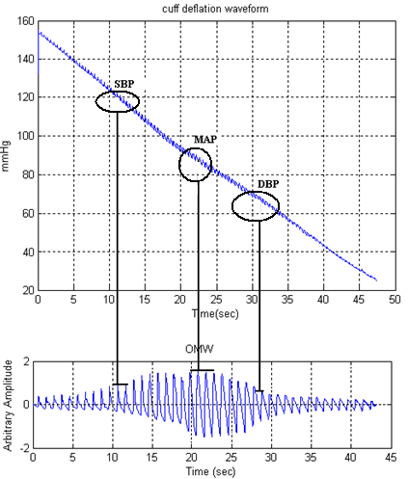
Pulse processing – Amplitude based
Maximum amplitude algorithm
Feature of interest: Maximum, area or amplitude of pulses
Physiology: maximum of the function is found to correlate with MAP
Preprocessing
Find maximum of pulses
Generate the function -envelope
Clean the envelope
Processing
MAP - pressure that corresponds to the maximum
SYS = MAP * K_SBP
DIA = MAP * K_DBP

Slide 11
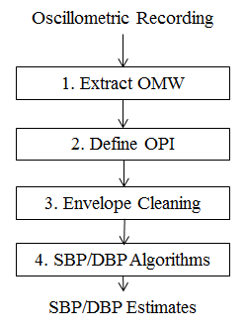
Oscillometric algorithm

Slide 12
Pulse processing – Amplitude based
Disadvantages
Disadvantages:
Does not use the wealth of information from the pulse
It is based on empirically derived coefficients for computing systolic and diastolic BP
Solution:
Estimate coefficients
Coefficient-free processing
Neural networks
Analysis of the pulse

Slide 13
Envelope processing – Amplitude based
Estimating coefficients
Goal: Adjust coefficient of the oscillometric algorithm
Method: Include personal information in the model
M. James, Simpliﬁed Model for the Design of an Oscillometric Blood Pressure Measuring System, PhD Thesis, University of Guelph, 2012.
Notes:
paper from guelph

Slide 14
Envelope processing – Amplitude based
Neural Networks
Neural networks (NNs) can approximate almost any nonlinear relationship that exist between inputs and outputs
Existing work:
The raw oscillometric waveform envelope (OMWE) is evenly sampled at specific increments of CP
The resultant samples are fed to the NN as input.
Our approach:
Modeling of the oscillometric waveform envelope as sum of two Gaussian functions as suggested in the literature
Parameters from Gaussian functions are extracted
These parameters are input to the network

Slide 15
Envelope processing
Neural Networks
Preprocessing
Processing
$${OMWE\left(t\right)=A}_{1}⋅exp\left\{\frac{−{\left(x−μ\right)}^{2}}{2{σ_{1}}^{2}}\right\} + A_{2}⋅exp\left\{\frac{−{\left(x−μ\right)}^{2}}{2{σ_{2}}^{2}}\right\}$$

Slide 16
Features that can be extracted from a single pulse and tracked in time
Preprocessing
and
processing
Feature
SYS,
DIA,
MAP
Feature
Time or
Cuff Pressure
Systolic & diastolic amplitude
Systolic, diastolic slope
ΔT/T ratio
Area under systolic curve
Pulse duration
Existence of dicrotic notch
Stiffness Index (SI)
Reflection Index (RI)
Notes:
Pulse waveform is a result of complex interaction between the left ventricle and blood circulation system. Pressure signal usually contains more information than is captured BP values and most of this information can be extracted from the pulse morphology,
Pulse represents 1 cycle of arterial blood pressure
Pulse is a graph of pressure over time (figure)
Pulse has first(systolic) peak, and sometime the second peak

Slide 17
Analysis of the pulse
Other features
MAP
diastolic
Feature
Reflection Index
$( RI= \left[\frac{P}{F}\right]×100\%$ )
Processing:
MAP – maximum of the function

Slide 18
Modeling
Accuracy needs to be improved
Rely on scientific approach - modeling
Applications
Development of new algorithms
Understanding the mechanisms
Setting parameters of existing algorithms
Calibration
Notes:
File: model and measurement

Slide 19

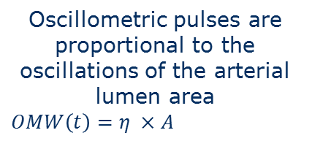
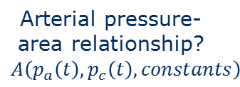
Innovation - modeling
$$p_{c}\left(t\right)+OMW(t)$$
Sum of harmonically related sinusoids modulated by respiration
Arterial pressure-area relationship?
$$A\left(p_{a}\left(t\right), p_{c}\left(t\right), constants\right)$$
Oscillometric pulses are proportional to the oscillations of the arterial lumen area
$OMW\left(t\right)=η ×$ $A$
Notes:
File: model and measurement

Slide 20
Innovation - modeling
Notes:
File: model and measurement

Slide 21
Oscillometric device Hardware
Notes:
File: model and measurement

Slide 22
Oscillometric device - Control
Notes:
File: model and measurement

Slide 23
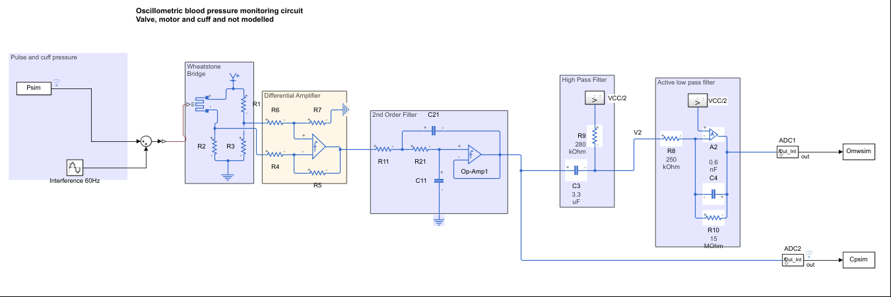
Data acquisition

Slide 24
Subject and Measurements
Adherence to measurement recommendations
Recommendations
Patients must remain silent during measurements,
be seated correctly with back support and legs uncrossed,
must have rested at least 5 minutes prior to taking the measurement.
should reside in a quiet environment.
Problem
current state-of-the­ art BP devices are not capable of sensing incorrect usage
Since only measurements following the recommendations are considered reliable
data from the reported studies could be indeterminate

Slide 25
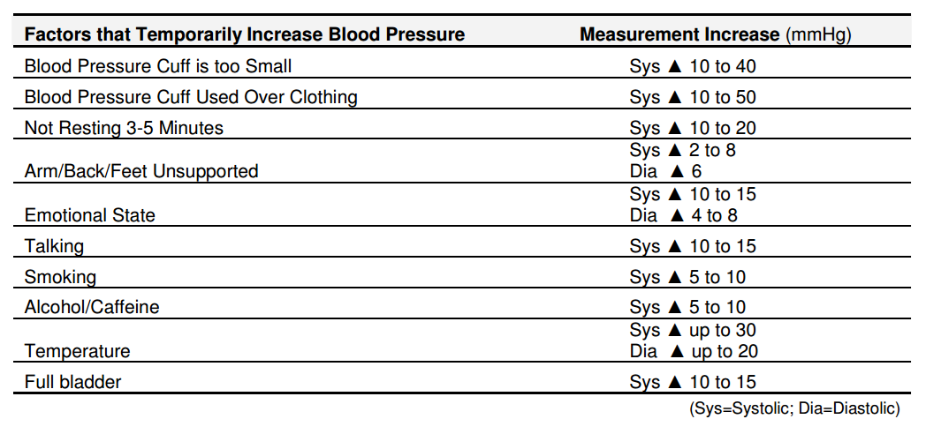
Factors that Can Elevate Blood
Pressure Readings
http://www.suntechmed.com/

Slide 26
Subject and Measurements
Adherence to measurement recommendations
A number of sensors is used
A number of research papers have appeared recently

Slide 27
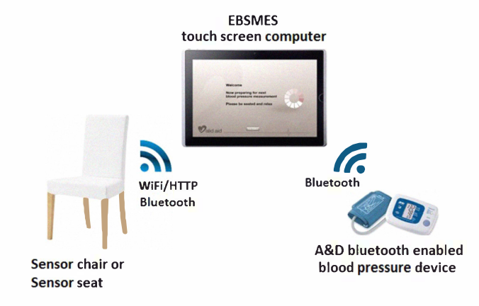
Subject and Measurements
Adherence to measurement recommendations
The system monitors activity and posture
The system records audio data and classifies as speech or silence.
S. Wagner et. al. , Context Classification during Blood Pressure Self-Measurement using the Sensor Seat and the
Audio Classification Device, PervasiveHealth Workshop, 2012.

Slide 28
Subject and Measurements
Adherence to measurement recommendations

